Slide 1
Hidden in Plain Sight: Unveiling the Secrets of Image Steganography
TEAM : CADefeat
UMIYA RATHOD
HARISH RATHOD

Slide 2
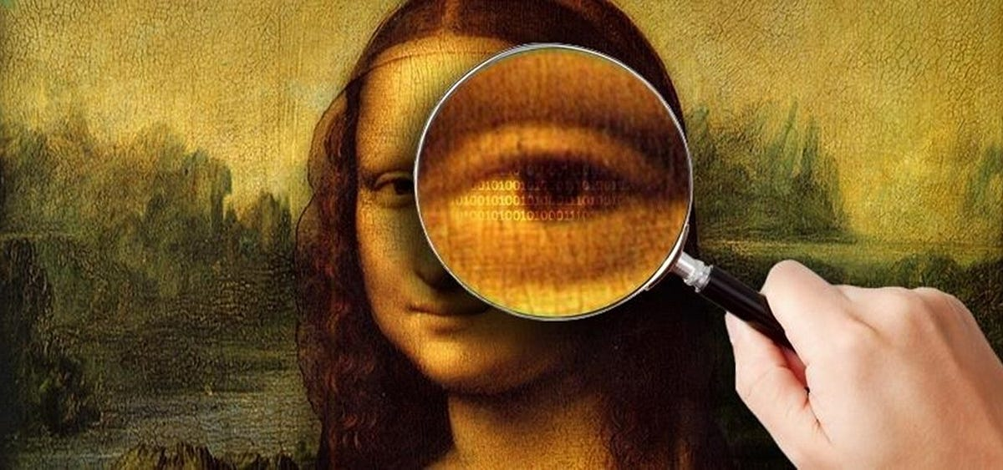
Problem Statement:Addressing the Need for Secure Communication
Problem: In an increasingly connected world, maintaining data privacy and secure communication is paramount.
Challenge: Conventional methods of secure communication may be conspicuous or complex, leaving sensitive information vulnerable.

Slide 3

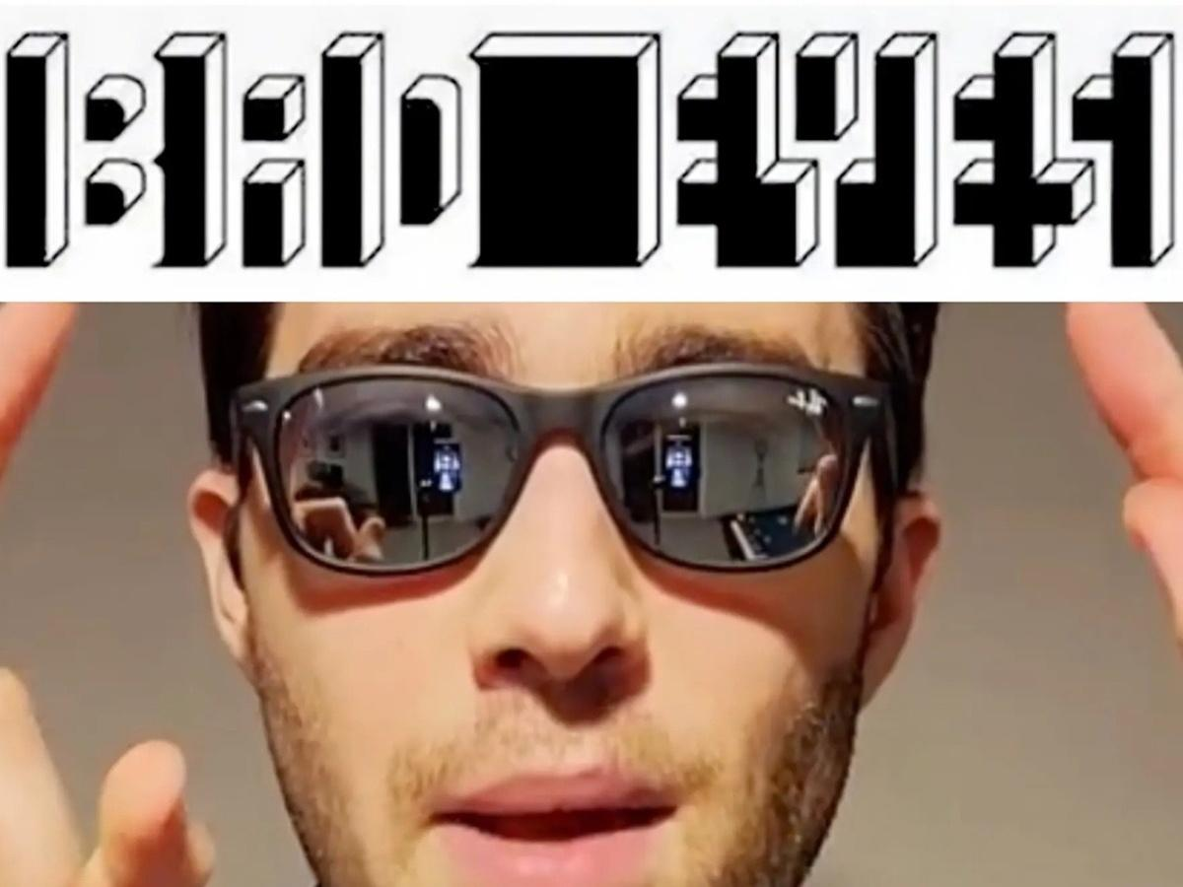

Slide 4
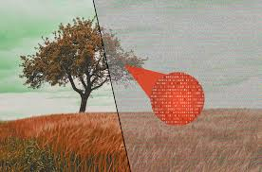
What is Image Steganography? The Solution
Image steganography is like a secret code that can be hidden in plain sight. It is a way of communicating securely without arousing suspicion. For example, a spy might use image steganography to send secret messages to their handler without being detected by the enemy.

Slide 5

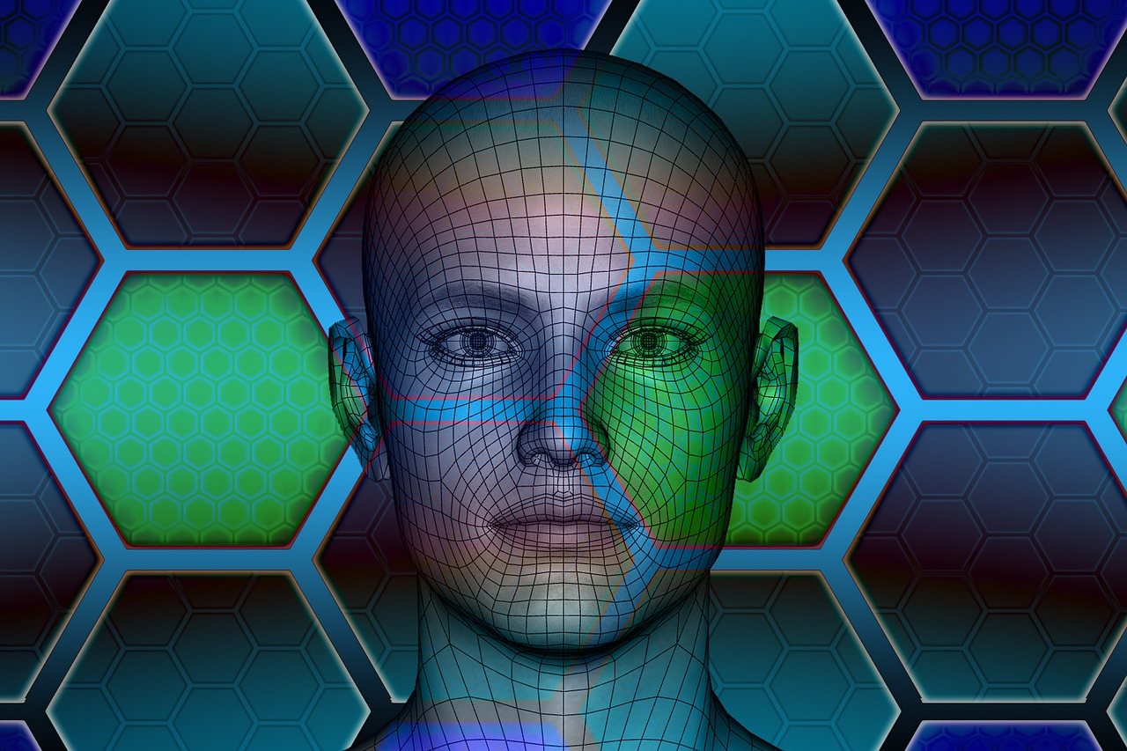
TECHSTACK
Programming Languages:
Python
JavaScript
Libraries and Frameworks:
Pillow (Python Imaging Library)
Development Tools:
Visual Studio Code
Git/GitHub (for version control)
Data Security:
Encryption Algorithms
Testing:
PyTest (for testing Python code)

Slide 6
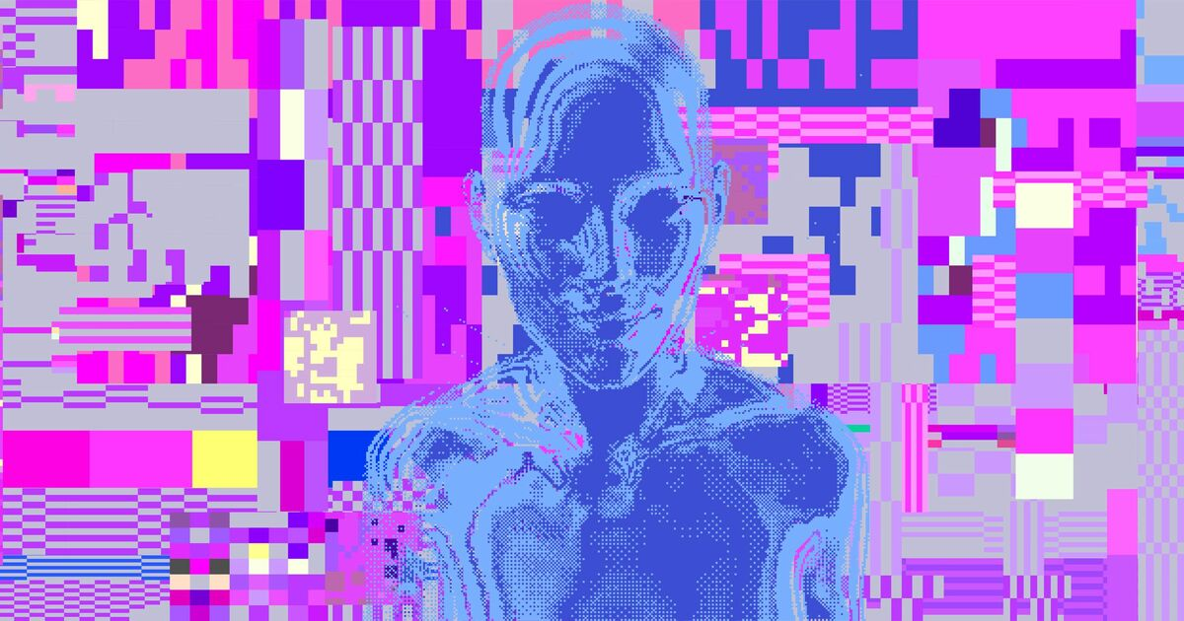
Key Features, that sets us apart!
Message encoding and decoding within images.
Simplicity and Accessibility
Support for various image formats.
Intuitive user interface for seamless operation.
Robust data security measures to protect concealed information.
Potential for Expansion

Slide 7

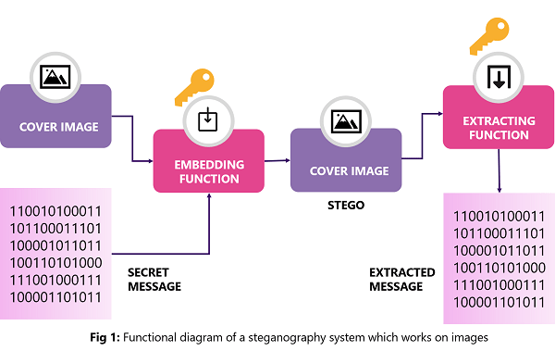
How It Works
Step 1: Select an image as the carrier.
Step 2: Enter the message you want to hide.
Step 3: Click the 'Encode' button.
Step 4: The system embeds the message into the image using a secure algorithm.
Step 5: The encoded image is generated.
Step 6: To decode, select the encoded image and click the 'Decode' button.
Step 7: The system extracts and displays the hidden message.

